Slide 1


Slide 2

Introduction

Slide 3

What is Google Summer of Code?
Google Summer of Code (GSoC) is a global program that matches students up with open source, free software and technology-related organizations to write code and get paid to do it!
The organizations provide mentors who act as guides through the entire process, from learning about the community to contributing code. The idea is to get students involved in and familiar with the open source community and help them to put their summer break to good use.
This program has brought together thousands of students and mentors from over 118 countries worldwide. As of November 2019, 686 open source projects, from areas as diverse as operating systems and community services, have participated as mentoring organizations for the program.

Slide 4
Goals of GSoC
Get more open source code written and released for the benefit of all.
Inspire young developers to begin participating in open source development.
Help open source projects identify and bring in new developers.
Give open source organizations the freedom to try new ideas.

Slide 5
Benefits for the Students
Accepted students gain exposure to real-world software development and employment opportunities in areas related to their academic pursuits.
The fact that you get to write code that people from all over the world can use - how cool is that!
Successful students have widely reported that their participation in GSoC made them more attractive to potential employers and that the program has helped greatly when embarking on their technical careers.
A crash course on soft skills and communication.

Slide 6
Am I Good Enough ?
The Technical Skills
Even if you have little experience in programming, it is possible to get accepted in GsoC. Note however that this is not the common case.
The common case is that you have to be good to get accepted in a GSoC project. Not crazily good, but competent enough in what you're interested in.
The important thing to remember is that what matters is how good you actually are at coding. That is, grades, previous experience etc. only matter if you have produced quality code because of them (and of course, if you have produced quality code without having those, that’s totally ok).

Slide 7
Am I Good Enough ?
The Soft Skills
The soft skills are greatly underrated unfortunately. However, they're
some of the most important skills for a software engineer not only for GSoC but in general. They span multiple areas:
You understand that trust, responsibility and communication and the ability to cultivate those are some of the most important assets for a developer.
You find out where to go for help with technical questions.
You take and respond well to feedback.
You can work independently.
You know when to ask questions.

Slide 8
Procedure

Slide 9
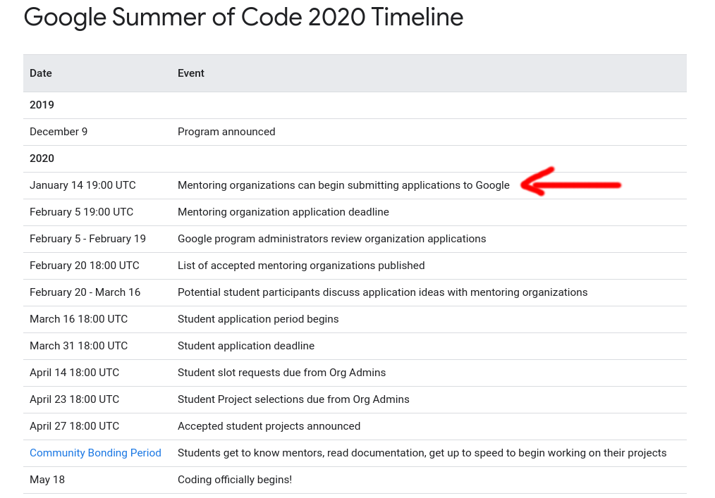

Slide 10
The Procedure in a Nutshell
First of all, be sure to check the GSoC timeline often to be sure you haven’t missed anything!
In a nutshell:
  Organizations put out some projects that students can do at about end of February.
  You communicate with orgs and eventually apply for some projects at the end of March.
  At the start of May, the accepted students are announced.
  Up to the end of May, there’s the bonding period with the organization.
  Then, from June to August is the coding period, in which for 3 months, you work on your project.
  At the end of each month, you get money and a review.

Slide 11
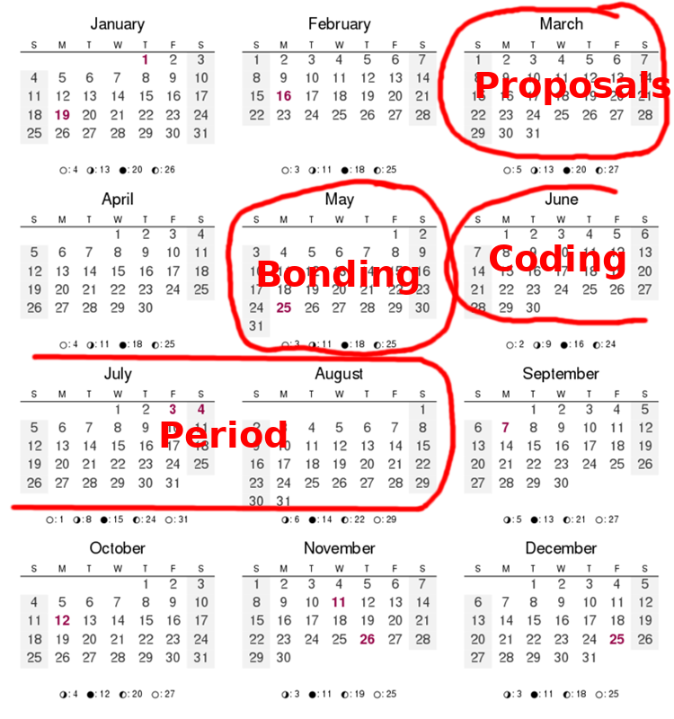

Slide 12
The Procedure
For you, everything starts when the project ideas are announced.
Every organization that has been picked by Google to participate in GSoC provides a list of project ideas. Every project idea is a project proposed to be completed by a single student in a period of 3 months.
For every project idea, there is one or more mentors that have decided to help the student that gets accepted complete the project.
In your part, there's one thing to do and you have to do it well: The Proposal.

Slide 13
The Procedure (cont’d)
Starting off, you have to spend some time browsing through all the organizations and their project ideas to see what interests you.
Be aware! It takes a reasonable amount of time to be done effectively. We’d say, about 1 week. And do that early!
Another thing to remember is that because an organization’s main topic is not in your interests, it doesn’t mean that it won’t have any project ideas that are in fact in your interests.

Slide 14
Getting Involved in the Community
Once you found the project ideas that are interesting to you, start getting involved in the community.
One way to do that is to start posting in IRC, Slack, forum or whatever way this project's contributors are communicating. Depending on the project, one or all of these might be high-traffic but it’s worth trying for multiple reasons.
Another way is to start communicating with the mentors of the ideas that you’re interested in. Maybe send an email making it clear that you’re interested in the specific project idea.
As you'd expect, soft skills are very important at this point!

Slide 15
What is the Point of the
First Interaction?
Ideally, after some time of communicating, the goal is that they think “he’s one of us” and you “I belong here”.
However, note that you should be honest. That is, accept the fact that you may very well not be one of them and vice versa. That’s ok, there are many other organizations out there. Certainly, both in the first contact but also in the whole duration of GSoC, we’d strongly advise you to never “fake” anything (both for ethical and practical reasons).

Slide 16
An Effective First Contact
Here are some general guidelines to keep in mind when you initiate communication with the project. Either by contacting a mentor privately or posting in some kind of public forum / chat.
Be polite. That’s obvious but you never know..
Be unambiguous, clear and to the point. That is, state clearly why you’re sending this email (the title by itself should make it clear).
Be proactive. That is, actively help the interaction move forward. Read the description of the project idea carefully so that you know what you're talking about. Make “to the point” questions. Ask him how could you get started with it. Ask him what kind of knowledge do you need.
Be concise. Don’t overdo it but when in doubt, opt for conciseness especially in the first contact.

Slide 17
After the First Contact
After the first contact and assuming it was good, the rest of the procedure is quite different depending on the organization.
There are 3 main things to do from now on:
1) Keep contact with them so that they don’t forget you.
2) Work in something related to your idea. This first of all helps you get familiar with the project and second, it helps you build trust. You show that you can actively help in a project (or at least that you have enough potential to do so).
3) Plan your course of action. Start thinking what is the best way to solve the problem, how you can make a specific roadmap, what are the difficulties / struggles etc.
4) Specifically, try to anticipate as many struggles as you can in order to ask for help early, so that you have them solved in the proposal.

Slide 18
Multiple Organizations
You have up to 3 proposals.
Basically, you should think wisely. A strong advise is to not compromise quality. That is, it probably won’t serve you well if you have a mediocre contact with 3 organizations rather than having a strong one with 1 organization.

Slide 19
The Proposal
The time has come to do your proposal. I assume, again, that you have built a strong connection with the org. That you have a very good understanding of your project idea, its difficulties, struggles etc. That you can communicate with your mentor and that you have familiarity with the project.
A proposal’s job is to convince the organization about 2 things:
That the project idea is worth it.
That you’re the best fit for it.
Your first step is to start preparing a proposal before the submissions open in order to get advantage of the draft proposals.

Slide 20
The Proposal (cont’d)
In the next couple of slides we will see an example proposal provided by Google that you find here. Using it, I will try to point out why it is good and what are the important parts.
This is a template proposal but I recommend that you read actual ones too.
Konstantin Käfer's Application for Summer of Code 2006 is one of my favorites.

Slide 21
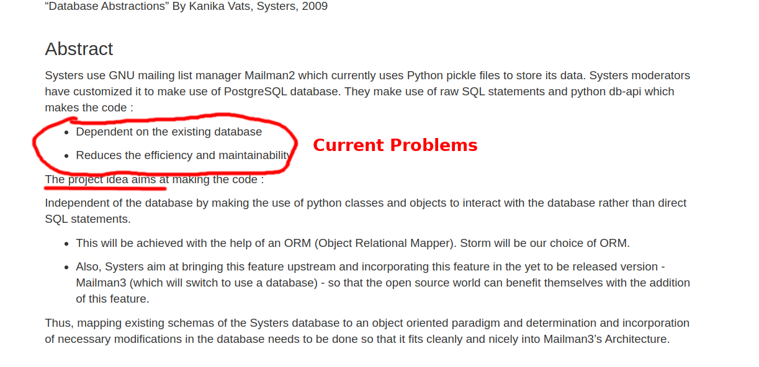
The Proposal (cont’d)

Slide 22
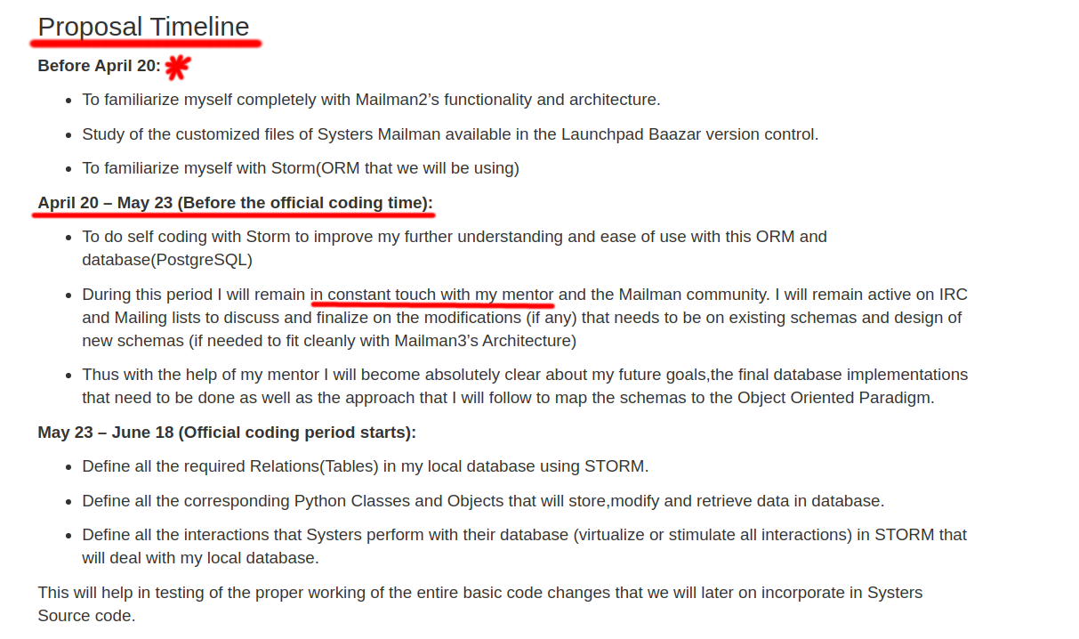
The Proposal (cont’d)

Slide 23
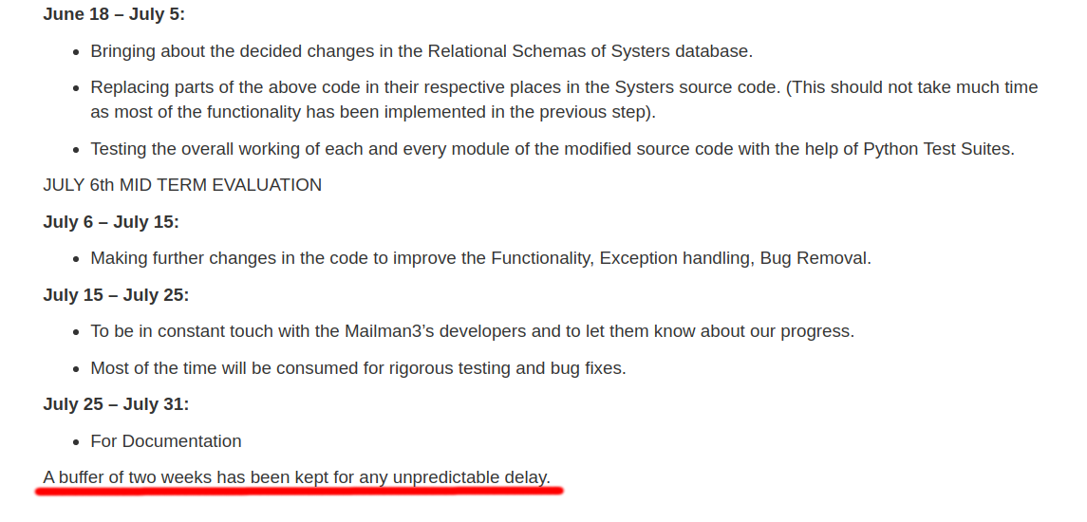
The Proposal (cont’d)

Slide 24
The Proposal (cont’d)
Warning!: Google example proposals miss a biography. Always include a description of yourself in a CV-like manner but possibly less formal.
You can find other layouts and many more proposals with simple Google search.
My advice is: Understand the sub-communication.
The proposal should scream why this project is beneficial to the community.
Also, it should be pretty obvious that you have thought this thing through. This includes a very well thought course of action and a quite specific roadmap.
Basically, after seeing your proposal for 10 seconds, you want the reader to think: “Ok, this person knows how to do the thing we need without giving us much trouble” (again, back to the "he's one of us").

Slide 25
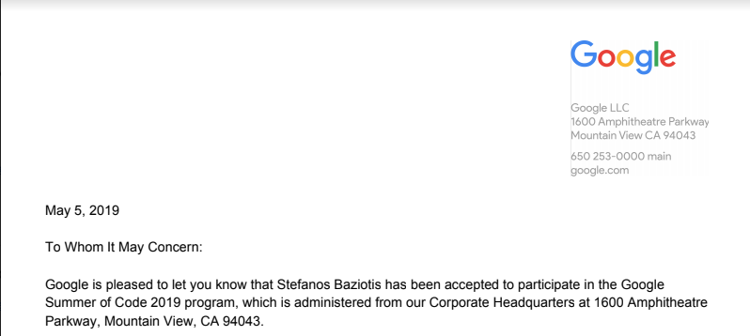


Slide 26
You Got Accepted!
Get excited because it really is amazing.
Before we get too excited though, let’s see what follows.
After the announcement of the accepted students is what is called the community bonding period.
It is also the time to acquire all the important knowledge that you may be missing and try to anticipate any difficulties in your project.

Slide 27
The Coding Period
After the community bonding period ends, the GSoC starts officially! It is called the coding period.
From now on, you’re expected to get sh*t done according to your roadmap.
The coding period is split into 3 months.
After each month, there’s an evaluation. The evaluator (which is your mentor(s)) judges you based on whether in the passed month you did what you were expected to do.
If you pass a month’s evaluation, you get $$ and continue working. Otherwise, you’re out of the program. :)
Other than the money, a passed evaluation is another way to say “you’re doing great!”.

Slide 28
The Coding Period (cont’d)
The most important thing during this period is to have fun and learn!
I really can’t re-iterate that enough. Take all the advice that you can, ask questions, exceed your and your mentor’s standards. This is the time to do all that and even more.
If possible, get in contact with the rest of the community (if you haven’t already) and be a part of the bigger picture.
Moreover, if you get the chance, communicate with other students. Either from the same organization or not.

Slide 29
The Coding Period (cont’d)
In the coding period, you want to have constant communication with your mentor according to what you have agreed upon.
Also, be sure that you generally get positive feedback from the rest of the community.

Slide 30
Use public communication as much as possible!
Advice

Slide 31
Thank you!

Slide 32
Thank you!
Questions?

